Slide 1
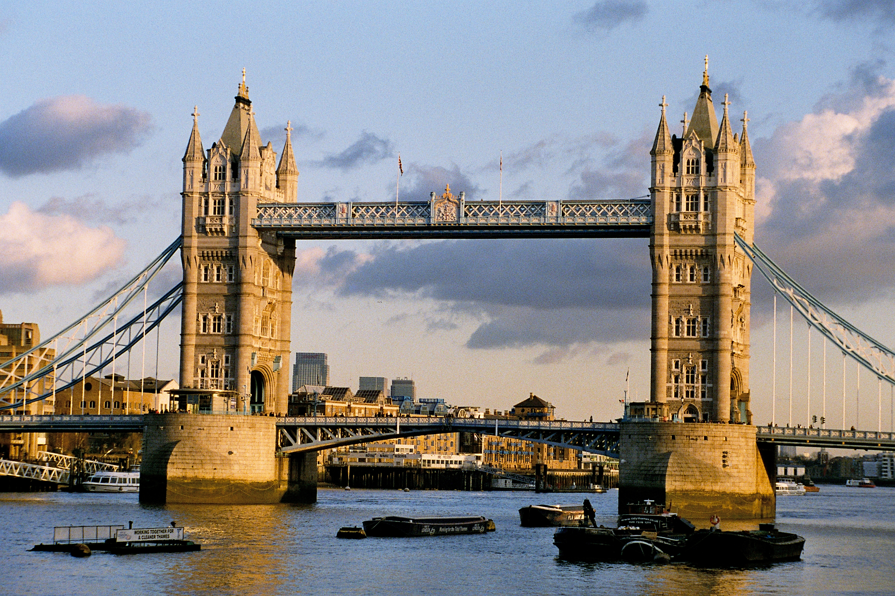

Tower Bridge
By madison

Slide 2
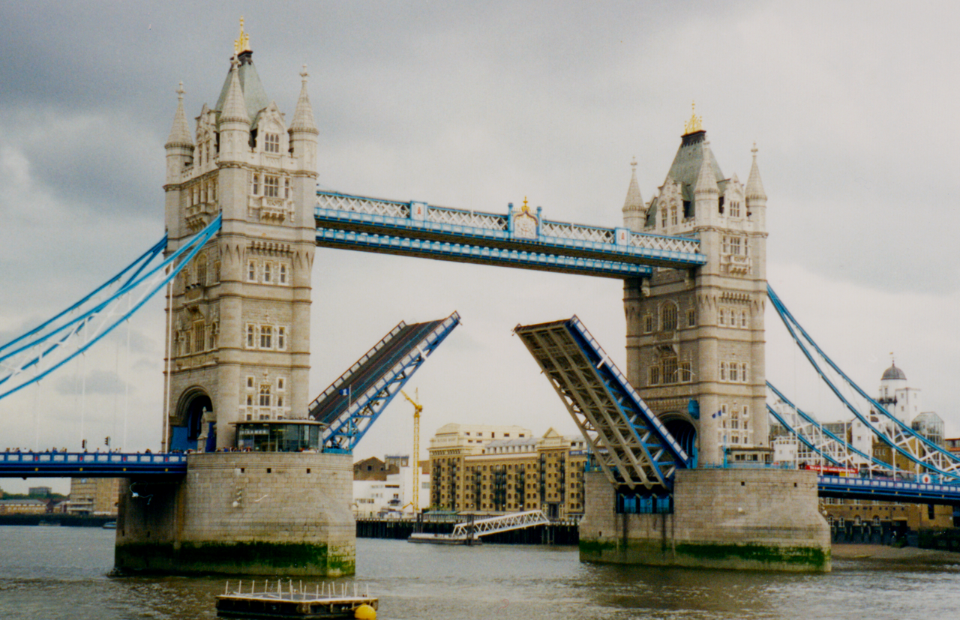
measurements
Height 213ft
Length 800ft 6in
Width 60ft

Slide 3
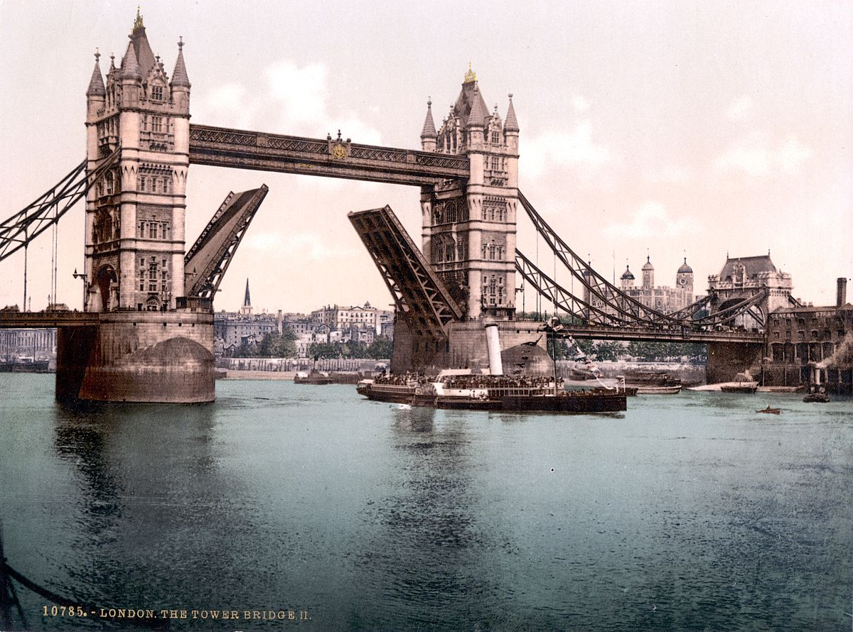
Interesting facts
The location of the Tower Bridge is near the London bridge
The Tower Brides moves like this up and down
The Tower bridge is not arched

Slide 4


Slide 5
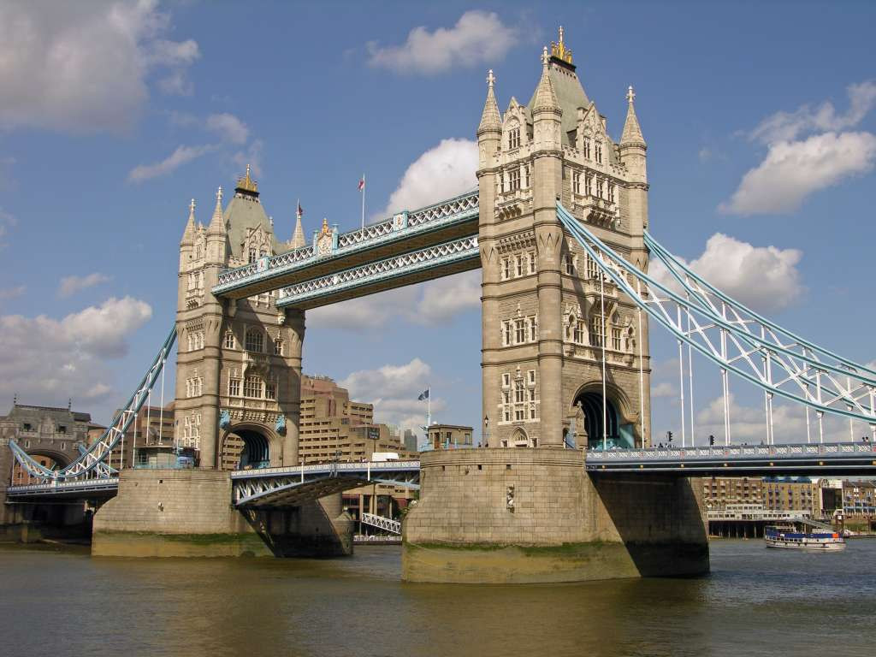
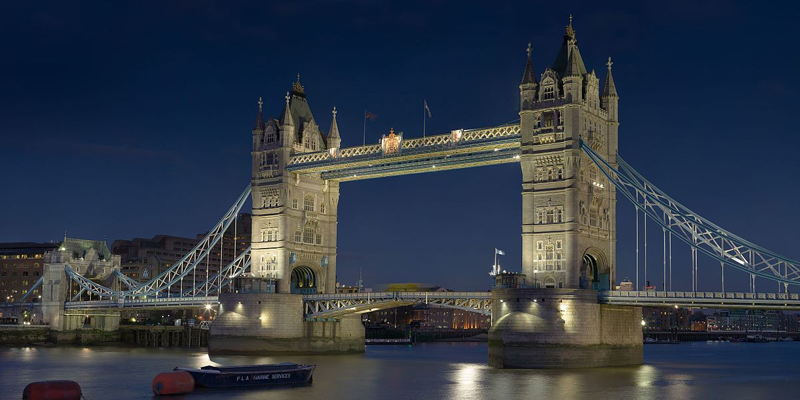
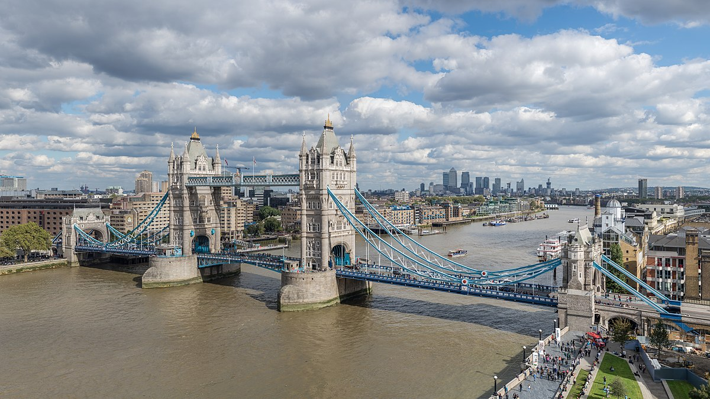
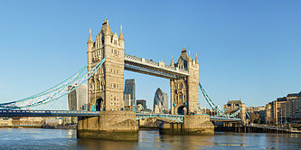
Researched and produced by Madison 2nd grade buck lake Elementary Tallahassee FL 2019

Slide 6

